Slide 1


Online Bidding Application
Srinivash | Roll No: 23suca21
FULL STACK WEB APPLICATION
JAVA | SPRING BOOT | VITE
DOCKER | RENDER | VERCEL

Slide 2

Introduction & Problem Statement
Project Vision
A robust full-stack online bidding platform empowering seamless transactions between sellers and buyers, designed for efficiency and scalability. Addresses the need for dynamic, real-time product auctions.
Current Challenges
Lack of integrated bidding solutions.
Inefficient product management.
Limited real-time user interaction.

Slide 3

Objectives of the Project
1
2
Enable Seamless Bidding
Ensure Scalable Backend
Develop a user-friendly interface for buyers to place bids and sellers to manage products effectively.
Build a resilient backend using Spring Boot for handling concurrent requests and data management.
3
4
Optimise User Experience
Facilitate Easy Deployment
Create a responsive frontend with Vite, ensuring fast load times and intuitive navigation.
Implement CI/CD practices using Docker, Render, and Vercel for streamlined deployment and updates.

Slide 4

System Architecture Overview
Frontend
User interface and presentation
Three-tier Architecture
Database
Backend
Persistent data storage
Application logic and APIs
The architecture follows a standard three-tier model, separating the user interface, application logic, and data storage for enhanced modularity and maintainability.

Slide 5




Technology Stack Deep Dive
Backend: Spring Boot
Frontend: Vite
Deployment: Docker
Database: H2
Robust framework for RESTful APIs.
Next-generation frontend tooling for fast development.
Containerisation for consistent environments.
Lightweight in-memory relational database.

Slide 6
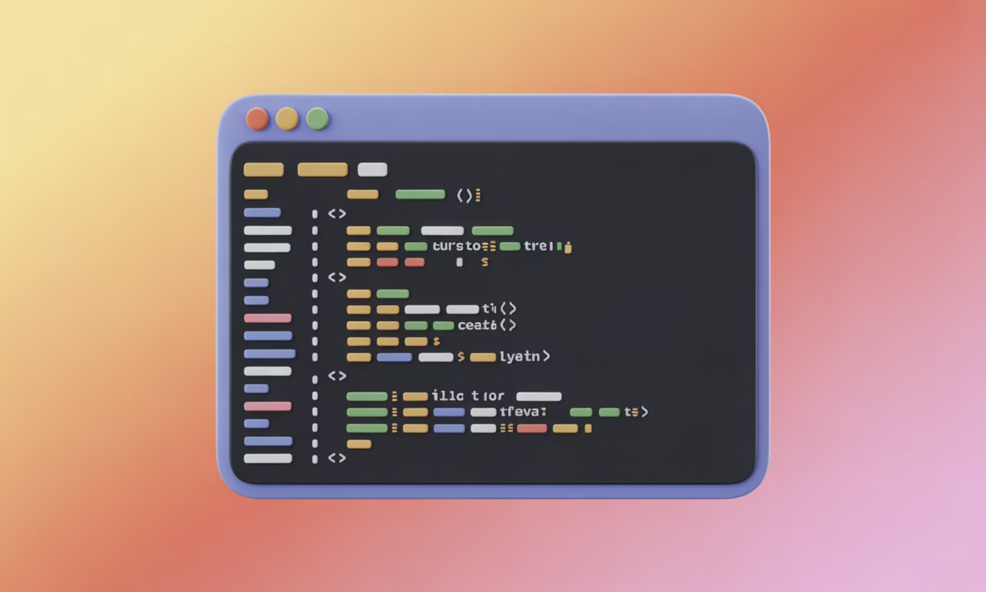
Backend Development: Spring Boot REST APIs
Core Functionality
Secure user authentication and authorisation.
Product management: creation, retrieval, updates, and deletion.
Bid management: placement, tracking, and notification system.
Integration with H2 Database via Spring Data JPA.
Key Technologies
Java: Primary language for backend logic.
Spring Boot: Simplifies API development.
Maven: Project build automation tool.

Slide 7
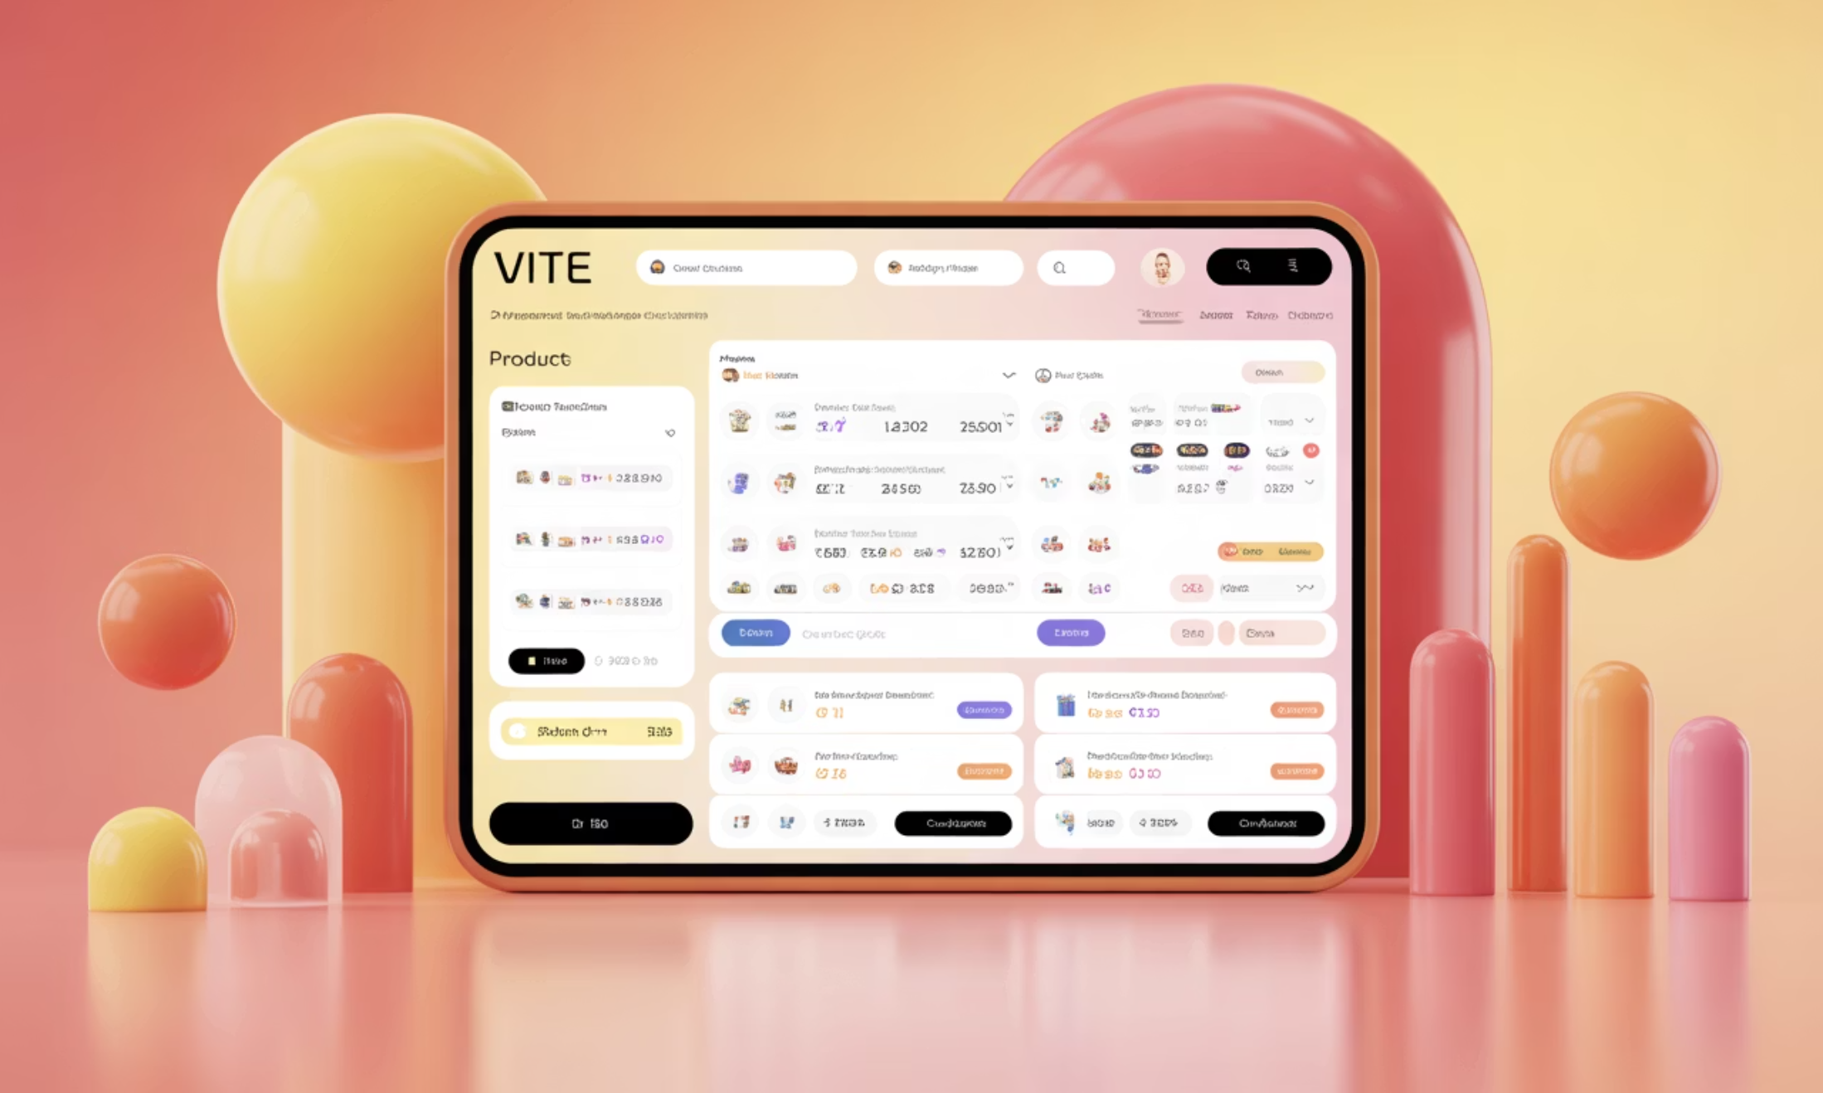
Frontend Development: Vite UI & API Integration
Dynamic User Interface
Responsive design for all devices.
Real-time updates for bids and product listings.
Intuitive navigation and search functionalities.
Seamless API Integration
Utilises JavaScript for API calls to the Spring Boot backend.
Efficient data fetching and display for optimal performance.
Modern HTML and CSS for a clean aesthetic.

Slide 8
Key Features & Functionality
Product Upload & Management
Real-time Bidding System
Sellers can effortlessly list products with descriptions, images, and starting bid prices.
Buyers can place bids and receive instant notifications on their bid status.
Comprehensive CRUD APIs
User Authentication
Full Create, Read, Update, Delete capabilities for products, users, and bids.
Secure login and registration processes with robust authorisation controls.

Slide 9

DevOps & Deployment Pipeline
Containerisation with Docker
Ensures environment consistency from development to production.
Cloud Deployment
Render: For backend API deployment.
Vercel: For seamless frontend application hosting.
Quality & Version Control
GitHub: Centralised code repository and version control.
SonarQube/SonarCloud: Code quality analysis and security scanning.
Postman: API testing and documentation.

Slide 10





Challenges & Future Enhancements
Real-time Bid Synchronisation
Implementing WebSockets for instant updates proved challenging but was successfully integrated.
Deployment Optimisation
Configuring Docker for Render and Vercel required fine-tuning for optimal performance and cost-efficiency.
User Interface Responsiveness
Ensuring a consistent experience across diverse devices involved extensive testing and iterative design.
Future: Payment Gateway
Integrate secure payment processing for completed transactions.
Future: Notifications
Expand notification system for various events, including outbid alerts and winning bids.

